Slide 1

What forms of collaboration are most effective?

Slide 2
Scaling Large Language Model-based Multi-Agent Collaboration (2025)

Slide 3

Scaling Large Language Model-based Multi-Agent Collaboration (2025)

Slide 4
Proposal A
Proposal B
Scaling Large Language Model-based Multi-Agent Collaboration (2025)

Slide 5
Proposal A
Suggestions for Proposal A
Proposal B
Suggestions for Proposal B
Scaling Large Language Model-based Multi-Agent Collaboration (2025)

Slide 6
Proposal A
Suggestions for Proposal A
Proposal C
Proposal B
Suggestions for Proposal B
Scaling Large Language Model-based Multi-Agent Collaboration (2025)

Slide 7
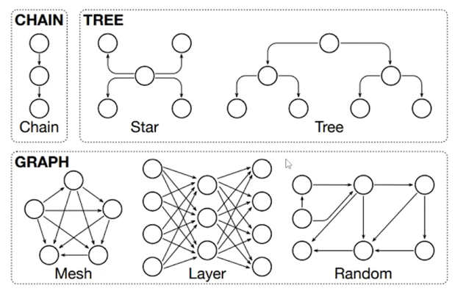
Scaling Large Language Model-based Multi-Agent Collaboration (2025)

Slide 8
Scaling Large Language Model-based Multi-Agent Collaboration (2025)

Slide 9
Scaling Large Language Model-based Multi-Agent Collaboration (2025)

Slide 10
Scaling Large Language Model-based Multi-Agent Collaboration (2025)

Slide 11
Scaling Large Language Model-based Multi-Agent Collaboration (2025)

Slide 12
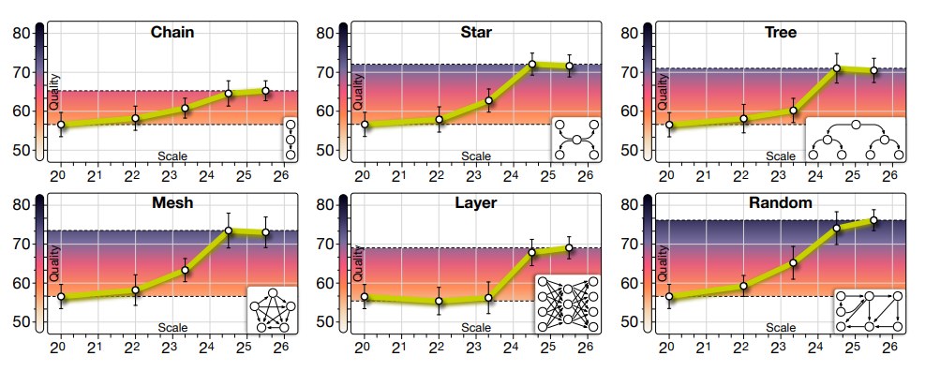
Scaling Large Language Model-based Multi-Agent Collaboration (2025)

Slide 13
Scaling Large Language Model-based Multi-Agent Collaboration (2025)

